Slide 1
Introduction to Information Systems
Information System Management
Course No: 0612-301
Md. Manirujjaman
Lecturer, CSE
DIU

Slide 2
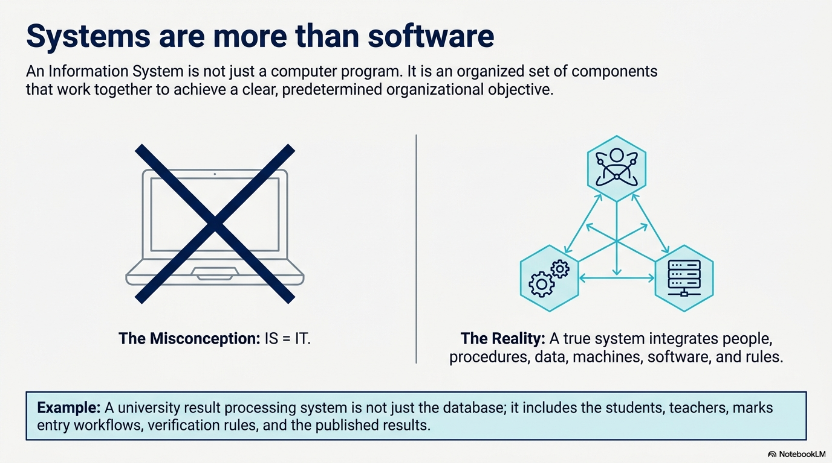

Slide 3
System Concept
A system –
  A way of thinking about organizations and their problems.
  Involves a set of techniques that helps in solving problems.
  An organized relationship among functioning units.
  An orderly grouping of individual components linked together to achieve specific objective/s.
  Each component is part of the total system and has to do its share of work for the system to achieve the intended goal.
  Components may refer to physical parts, managerial steps, etc.
Notes:
A university is a system because it has several interconnected parts—such as the administration, HR, accounts, IT, and academic departments. Each part performs its own function, but all work together to achieve a common goal: providing quality education to students.

Slide 4
System Concept
Therefore, The study of systems concepts has three basic implications –
  A system must be designed to achieve a predetermined objective
  Interrelationships and interdependence must exist among the components.
  The objectives of the organization as a whole have a higher priority than the objectives of its subsystems.
Notes:
A system is goal-oriented:
Every system is created to achieve a specific purpose. For example, a university’s system is designed to provide quality education.
All parts are connected and depend on each other:
Each department or unit in a system must work together. For instance, in a hospital, the doctors, nurses, and billing department depend on each other to serve patients effectively.
The overall goal is more important than individual goals:
The main objective of the whole organization comes first. For example, in a university, if the HR department recruits fewer teachers than actually needed to reduce salary costs, it may lower the overall education quality. Therefore, the university’s main goal of providing quality education should come before departmental cost-saving goals.

Slide 5
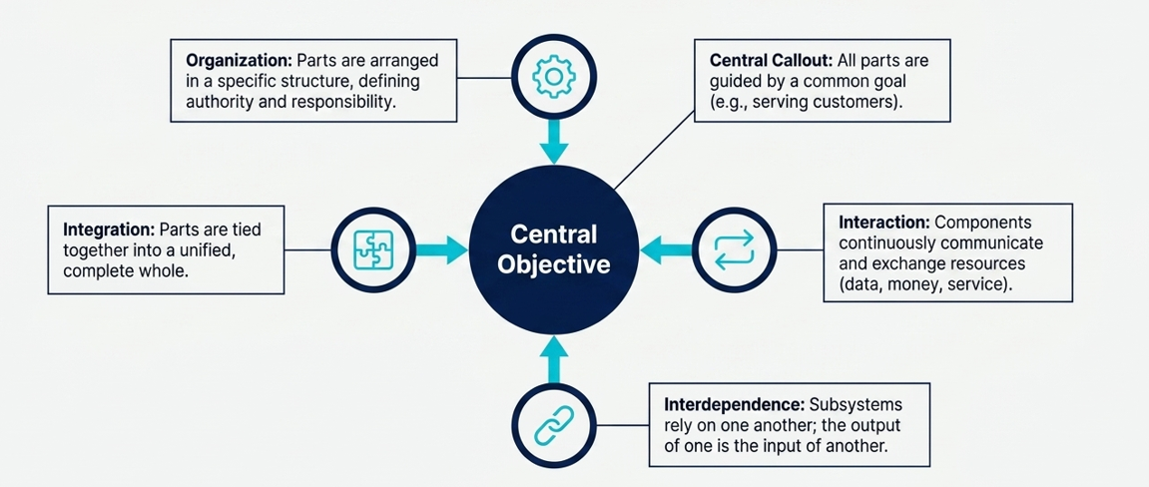
Characteristics of a System
For a system to function, its components cannot exist in isolation. They must be aligned.
  Organization
  Interaction
  Interdependence
  Integrations
  Central objective
Notes:
1. Organization
A system has organized parts or components arranged in a specific order to achieve a goal.
Each part has a role and works according to a plan.
Example:
In a university, departments like CSE, EEE, and BBA are organized under different faculties, but all follow the university’s structure to maintain smooth operations.
2. Interaction
All components of a system interact with each other to exchange information or resources.
These interactions help the system work as a whole.
Example:
When a student pays tuition fees, the finance system updates the record, and the academic system allows the student to register for courses.
Interdependence
Each part of a system depends on other parts.
If one part fails, it can affect the entire system.
Example:
In a software company, the testing team depends on the development team to deliver the code.
If developers delay, testers cannot perform their work on time.
Integration
Integration means combining all parts so they work together as a single unit.
It ensures the output of one part becomes useful input for another.
Example:
In a business, the sales system is integrated with the inventory system — when a product is sold, the stock level is automatically updated.

Slide 6
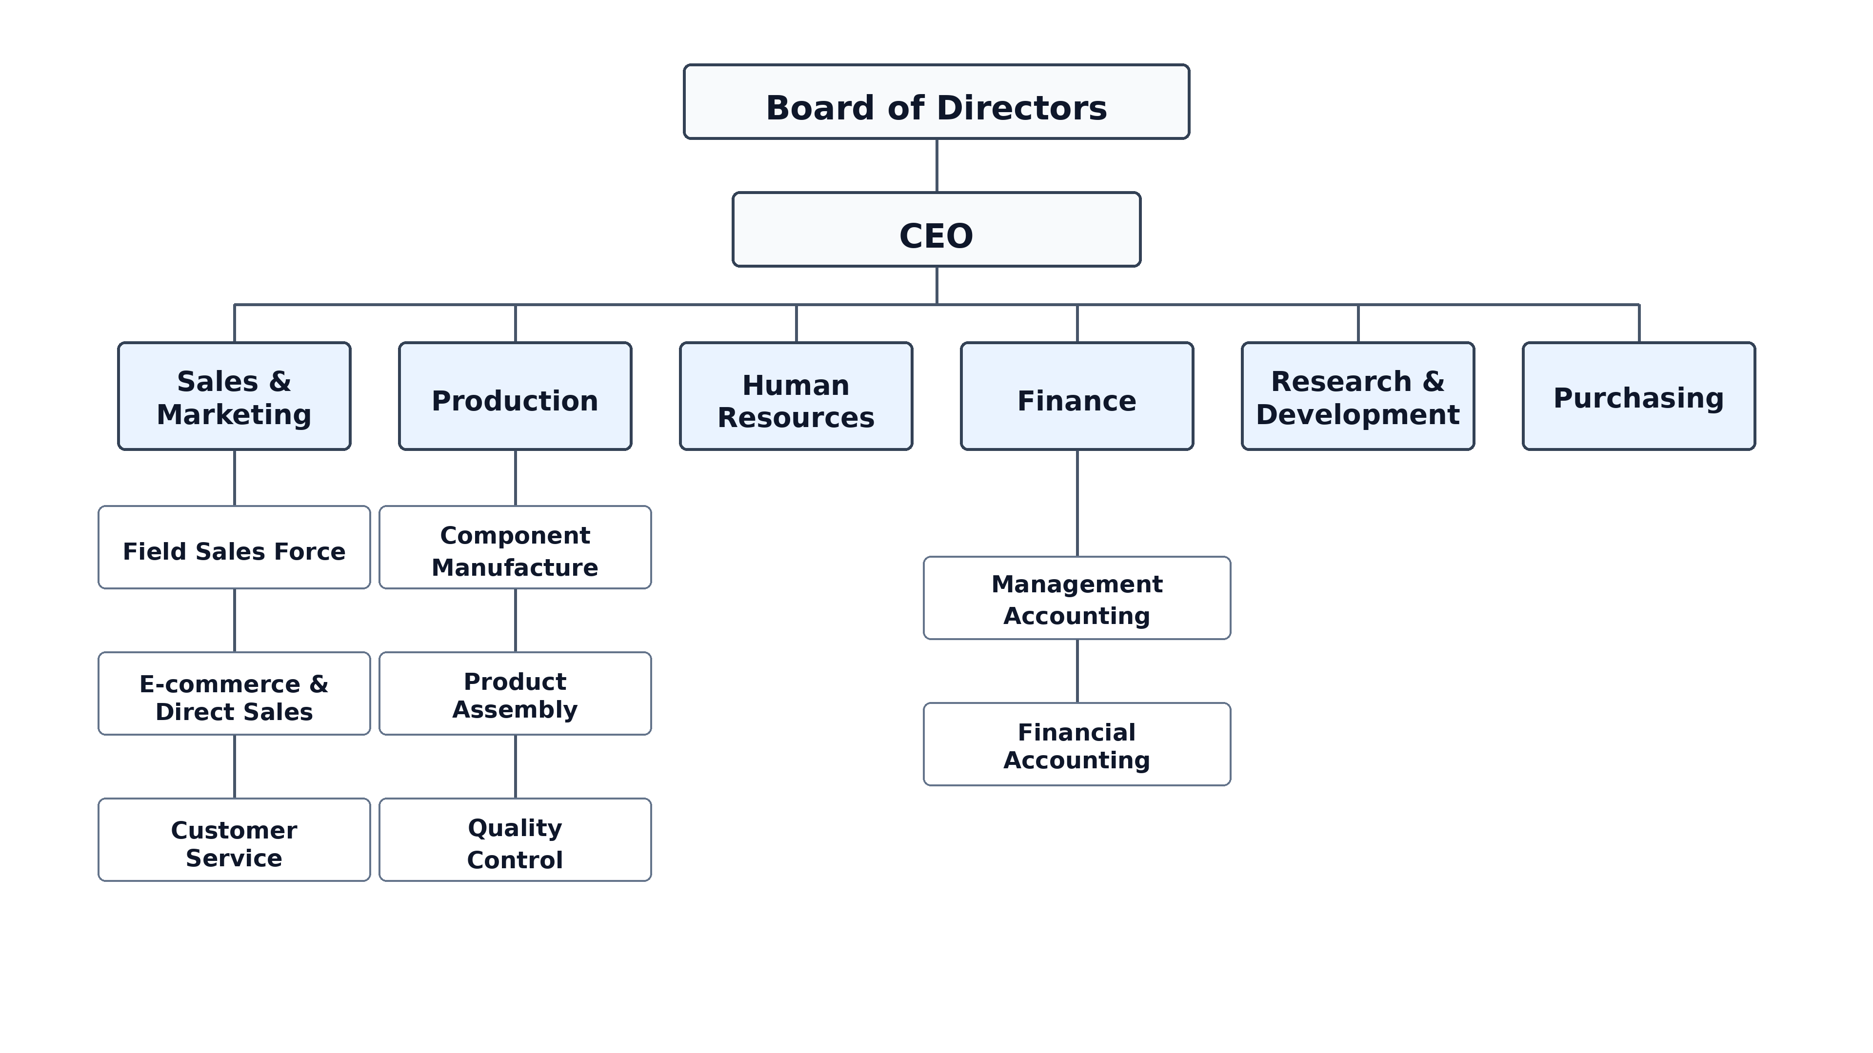
Characteristics of a System
Organization
  Implies structure and order.
  The arrangement of components that helps to achieve objectives.

Slide 7
Characteristics of a System
Interaction
  How each component functions with other components.
  Communication and exchange of information, energy, or resources between the components of a system.
  Essential for coordination and functionality.
Interdependence
  Dependence of each subsystem or component on others.
  Certain subsystem may need the outputs of other subsystem as input.
  Ensures the contribution of each subsystem to achieve the system objectives.

Slide 8
Characteristics of a System
Integration
  Concerned with how a system is tied together.
  The harmonious functioning of all components as a unified whole.
  All the parts of the system need to work in sync even if their jobs are unique.
  Proper integration maximizes the system's output and effectiveness.
Central Objective
  Guides the functioning and alignment of all components.
  It can be real or stated.
    A company might state that its primary objective is to "serve customers," but in reality, its operations might prioritize maximizing profit.

Slide 9
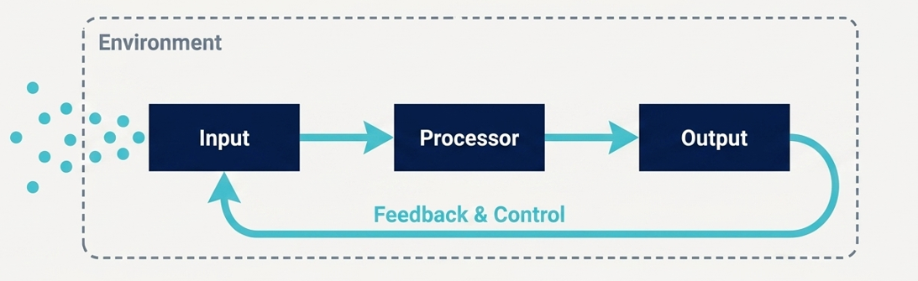
Elements of a System
Inputs and outputs
Processors
Control
Feedback
Environment
Boundaries and interface

Slide 10
Elements of a System
Inputs:
Input is the data, materials, or resources that enter a system so that the system can work on them.
A system cannot produce useful results without receiving proper input.
University System
Student admission information
Course registration data
Attendance records
Exam marks
Tuition fee information
Banking System
Customer account information
Deposit amount
Withdrawal request
Loan application
Transaction details
E-commerce System
Customer order
Product selection
Delivery address
Payment information
Customer search history

Slide 11
Elements of a System
Process / Processor:
Processing means working on the input and converting it into useful information or results.
The processor is the part of the system that performs this work. Processor provides actual transformation of input into output.
University System
Calculate attendance percentage
Calculate GPA
Check tuition fee status
Process course registration
Prepare examination results
Banking System
Check account balance
Calculate loan interest
Verify transaction
Transfer money between accounts
E-commerce System
Calculate total order price
Check product availability
Calculate delivery charge
Process online payment
Recommend products

Slide 12
Elements of a System
Output:
Output is the final information, result, or service produced by the system after processing the input.
University System
Semester result
Transcript
Attendance report
Class routine
Payment receipt
Banking System
Account balance
Bank statement
Transaction receipt
Loan approval or rejection
E-commerce System
Order confirmation
Invoice
Delivery tracking information
Product recommendation

Slide 13
Elements of a System
Control:
Control refers to the rules, policies, and decisions that guide how the system should operate.
It makes sure that the system works correctly and follows organizational rules. control is also defined as a decision-making subsystem that governs input, processing, and output.
University System
A student needs at least 70% attendance to sit for an exam.
A student cannot register without paying required fees.
Only authorized teachers can enter marks.
Banking System
ATM withdrawal has a daily limit.
Large transactions may require additional verification.
A customer cannot withdraw more than the available balance.
E-commerce System
Orders cannot be placed for out-of-stock products.
Refunds must follow company policy.
Some payment methods may have transaction limits.

Slide 14
Elements of a System
Feedback:
Feedback is information about the system's performance or output that is sent back to improve or correct the system.
If something is wrong, feedback helps the organization identify the problem and make changes.
University System
Students report incorrect results.
Students give course evaluations.
Teachers report problems with the student portal.
Banking System
Customers report failed transactions.
Customers complain about ATM problems.
Fraud reports help improve security.
E-commerce System
Customers give product reviews.
Customers report late delivery.
Customers request refunds for damaged products.

Slide 15
Elements of a System
Boundary:
A boundary defines what is inside the system and what is outside the system. It helps us understand the scope of a system.
University System
Inside:
Students
Teachers
Departments
Accounts office
Exam office
Library
Outside:
UGC
Ministry of Education
Other universities
Job market
Banking System
Inside:
Customer accounts
Employees
ATM services
Loan department
Outside:
Central bank
Other banks
Government regulators

Slide 16
Elements of a System
Interface:
An interface is the point where two parts of a system, or two different systems, communicate with each other.
University System
University payment system ↔ Bank/payment gateway
Student portal ↔ Examination system
Library system ↔ Student database
Banking System
ATM ↔ Bank server
Mobile banking app ↔ Bank database

Slide 17
Types of Systems
Physical System
A physical system is a real system that we can see and touch. It consists of physical objects or components working together.
Examples:
  Computer lab
  University campus
  Hospital
A physical system can also be static or dynamic.
Static system: A system that remains mostly unchanged over time.
(a university building structure, printed class routine, organization chart.)
Dynamic system: A system that changes continuously with time.
(traffic control system, online student portal, stock market, hospital patient-management system.)

Slide 18
Types of Systems
Open System
An open system interacts with its external environment.
It can receive input from outside and can also produce output to the outside environment.
Example: University, Hospital, Bank, E-commerce company.
Closed System
A closed system has very little or no interaction with its outside environment.
In real life, completely closed systems are rare. We usually call a system closed when outside interaction is very limited.
Example: A sealed chemical experiment, A closed laboratory experiment.
Information System
An information system is a system that collects data, processes it, stores it, and provides useful information. Usually, it includes people, processes, data, and technology working together.
Example: Student Management System, Library Management System, Banking System

Slide 19
Open Systems
Has many interfaces with its environment.
Permits interaction across its boundary to exchange inputs and outputs.
Five important characteristics –
  Input from Outside
  An open system receives data, resources, or materials from its external environment.
  Example: A university receives new students, UGC rules, fees, and job-market requirements.
  Self-Adjusting / Self-Regulating
  An open system can change or adjust its activities to remain stable and effective.
  Example: If many students fail a course, the university may arrange extra classes or change the teaching method.
  Entropy
  Without proper maintenance and improvement, a system can become weak, disorganized, or less effective over time.
  Example: If a university does not update software, labs, or syllabus, its system may become outdated.

Slide 20
Open Systems
Has many interfaces with its environment.
Permits interaction across its boundary to exchange inputs and outputs.
Five important characteristics –
  Process, Output, and Cycles
  An open system follows a continuous cycle: input → process → output → new input.
  Example: Admission → classes → exams → results → feedback → next semester.
  Differentiation
  Different parts of the system become specialized for different tasks.
  Example: Admission handles enrollment, Accounts handles fees, and the Exam Office handles results.
  Equifinality
  The same goal can be achieved through different methods or paths.
  Example: Student learning can happen through classroom lectures, online classes, labs, projects, or internships.

Slide 21
Information Systems
Information system –
  a set of interrelated components
  that collect (or retrieve), process, store, and distribute information
  to support decision making and control in an organization
Data are streams of raw facts representing events in the organizations and the environment.
Information means data that have been shaped into a form that is meaningful and useful to human beings.

Slide 22
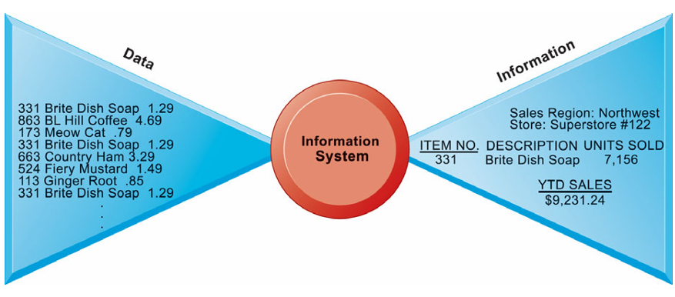
Information Systems
Raw data of a supermarket are being processed to extract useful information

Slide 23
Information Systems
The activities/functions/elements of information systems –
  Environment
    The external factors that impact and shape the system
  Inputs
    Captures or collects raw data from within the organization or from its external environment
  Processing
    Converts this raw input into a meaningful form
  Outputs
    Transfers the processed information to wherever it will be used
  Feedback
    Output that is returned to appropriate members of the organization to help them evaluate or correct the input stage
Notes:
An information system works like a cycle — it takes in data, processes it, produces results, and then uses feedback to improve.
It has five main parts:
Environment – Things outside the system that affect it.
Inputs – Raw data collected from inside or outside the organization.
Processing – The system changes that raw data into something meaningful.
Outputs – The useful information that comes out and gets shared or used.
Feedback – Information sent back to improve or correct future actions.

Slide 24
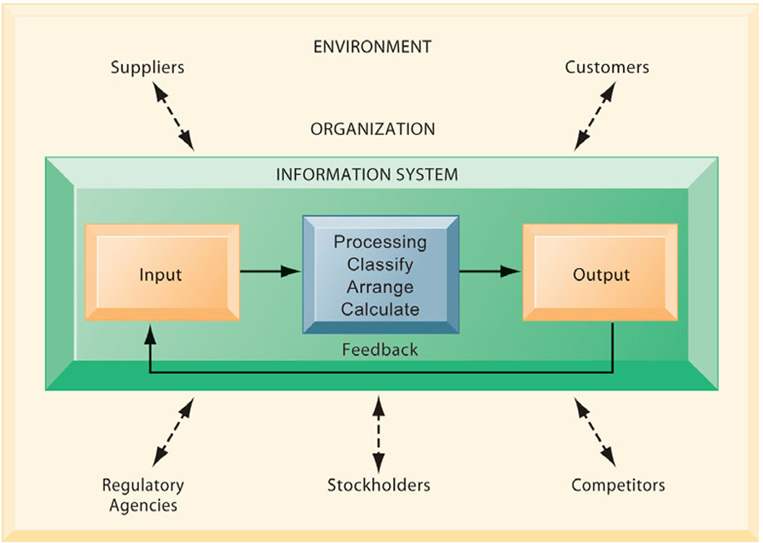
Information Systems

Slide 25
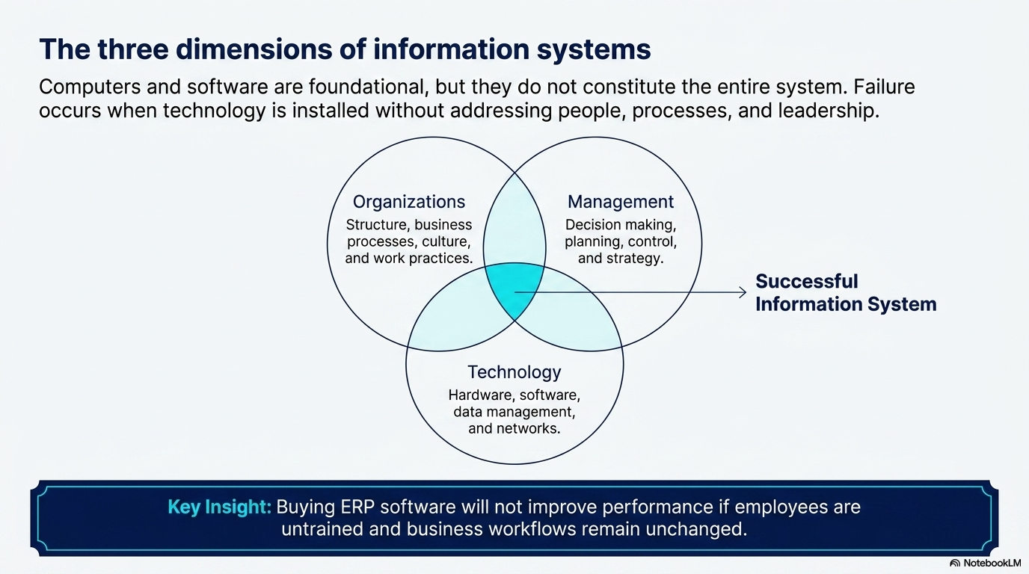

Slide 26
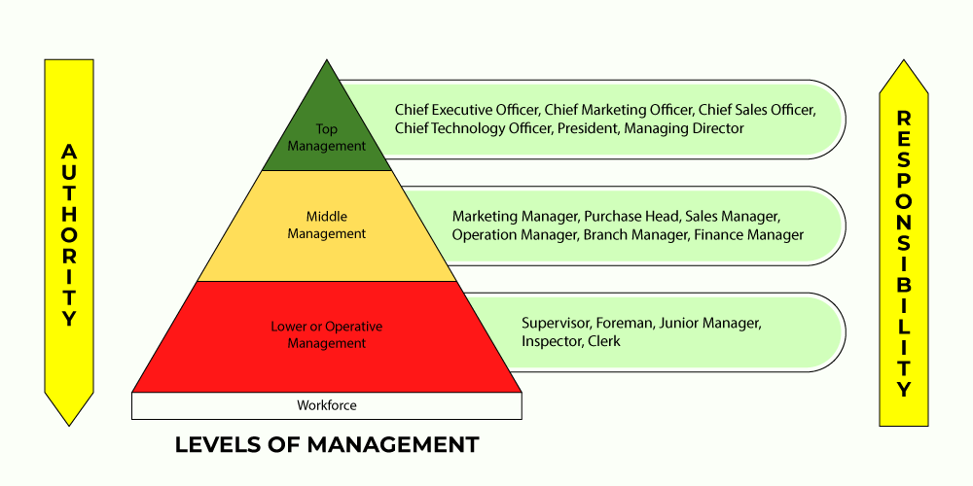
Organizations

Slide 27
Organizations
Top level management
    Formulates objectives, plans, and policies.
    Makes long-range strategic decisions.
    Coordinates and control of the performance.
    Analyses of the business environment.
    Sets up an organizational framework.
    Assembles of the resources.
    Ensures financial performance of the firm.
    Requires summarized information from a variety of sources to attain goals.
    Relatively open, dynamic, and adaptive.
    Decisions are mostly judgmental.

Slide 28
Organizations
Middle management
  Carries out the programs and plans of senior management.
  Interprets of the policies framed by the Top Level Management.
  Selects of suitable operative and supervisory personnel.
  Assigns of duties and responsibilities to the Lower Level Management.
  Motivates employees to get desired objectives.
  Cooperates with the entire organization.

Slide 29
Organizations
Lower management
  Also known as Supervisory or Operational Level Management.
  Issues of orders and instructions.
  Makes day-to-day, relatively structured control decisions.
  Monitors the daily activities of the business.
  Assigns and assists the workers
  Represents workers’ grievances.
  Ensures a safe and proper work environment.
  Helps the middle level management.
  Encourages initiative of employees.
  Needs detailed internal information.

Slide 30
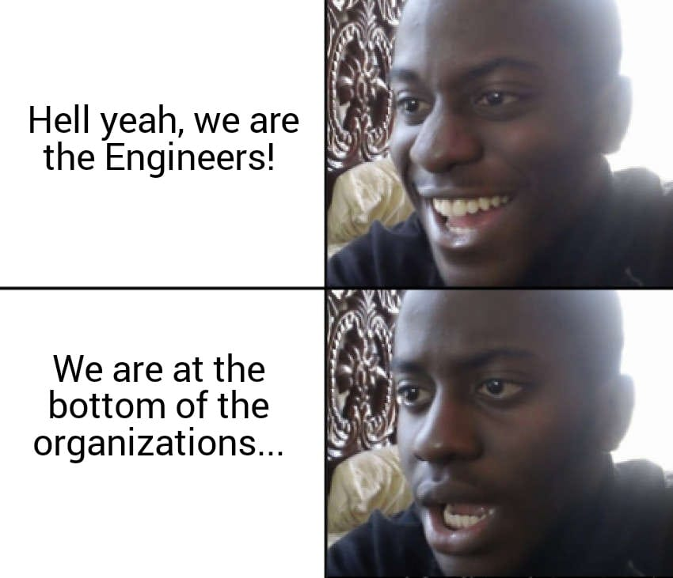
Organizations
Workforces include –
  Data workers
    Clerks, secretariats, etc.
  Knowledge workers
    Engineers (😔), scientists, architects, etc.
  Production workers
  Service workers
  And, many others

Slide 31
Organizations
Business functions
  Sales, marketing, manufacturing, production, finance, accounting, HR, etc.
Formal rules
Informal work practices
Automation
Differing perspectives, conflicts, compromises, and agreements.
Unique culture
  Fundamental set of assumptions, values, and ways of doing things.
  Accepted by most of its members.
Notes:
1. Business Functions
Every organization has different departments or functions.
Examples:
Sales and Marketing: promote products or services.
Production: creates the main product or service.
Finance and Accounting: manages money, salary, budget, and expenses.
HR: hires employees and manages staff.
Example:
In a university, admission office, accounts office, exam office, departments, and library all work together.
2. Formal Rules
Formal rules are official rules of the organization.
Examples:
Office time is 9 AM to 5 PM.
Students must attend 70% classes.
Employees must follow leave policy.
Teachers must submit marks before the deadline.
These rules help the organization run properly.
3. Informal Work Practices
Informal work practices are unofficial ways people do their work.
Examples:
Teachers share notes with students through WhatsApp.
4. Automation
Automation means using technology to do work faster and with less manual effort.
Examples:
Online admission system
Biometric attendance system
Online result system
Automatic fee payment system
Library book management software
5. Different Opinions and Conflicts
People in an organization may have different ideas, needs, and goals.
Examples:
Teachers may want more time to finish syllabus.
Administration may want exams on fixed dates.
6. Unique Culture
Every organization has its own culture.
Culture means the common values, habits, and ways of working accepted by most members.

Slide 32
Dimensions of Information Systems
Management
  Manage what already exists.
  Create new products and services.
  If needed, re-create the organization.
Information Technology Infrastructures
  Provides the foundation, or platform, on which the firm can build its IS.
  Hardware and software.
  Data management technology.
  Networking and telecommunications technology.

Slide 33
Information Systems
Information system enables the firm to –
  increase its revenue or decrease its costs by providing information
  that helps managers make better decisions
  that improves the execution of business processes
The decision to invest in any new information system is determined by the extent to which the system will lead to –
  better management decisions
  more efficient business processes
  higher firm profitability

Slide 34
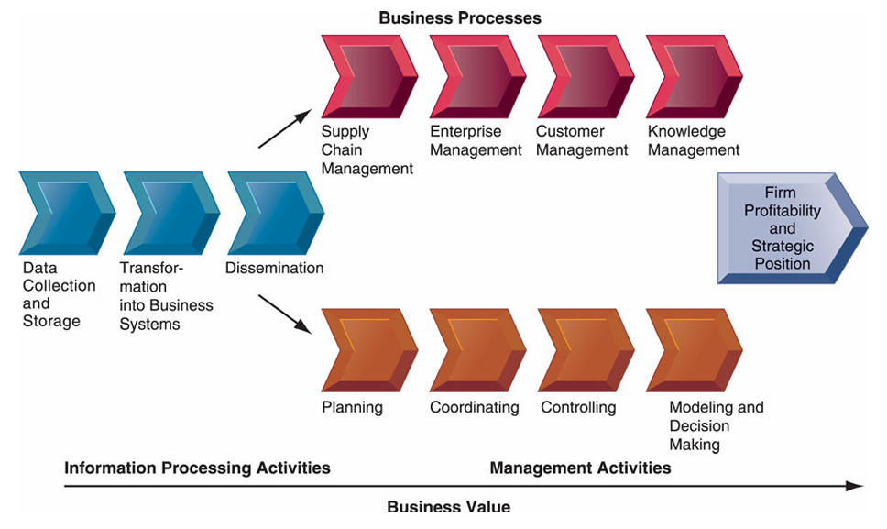
Information Value Chain
Technology creates value only when information leads to better human action.
Notes:
Information Value Chain means the process of converting raw data into useful information, and then using that information to make better decisions and create business value.
1. Data Collection and Storage
Collect raw data and store it
Customer orders, payment data, product views, delivery status, customer reviews.
2. Transformation into Business Systems
Convert raw data into useful business information.
Sales reports, stock reports, customer behavior analysis.
3. Dissemination
Share information with the right people/departments
Inventory team gets stock alerts, marketing team gets customer interest reports
4. Business Processes
Use information to improve daily operations.
Supply chain manages stock, customer management handles complaints, knowledge management improves service
5. Management Activities
Managers use information for decisions.
Plan discounts, control delivery delays, decide which products to promote
6. Business Value
Final benefit for the organization
Higher profit, faster delivery, better customer satisfaction, stronger market position

Slide 35
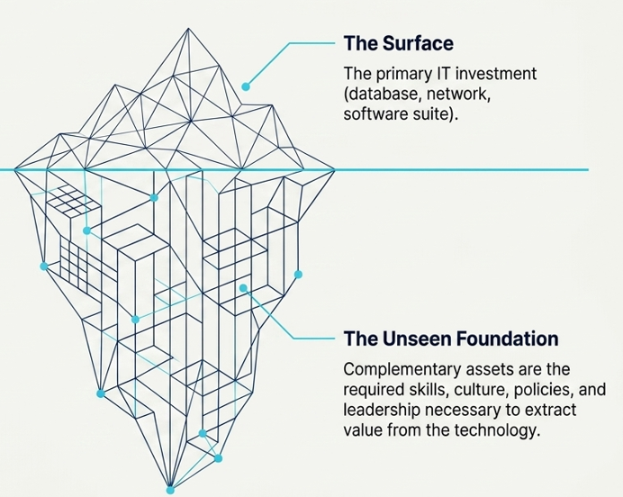
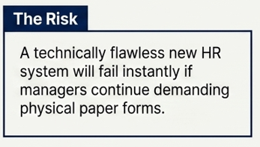
Complementary Assets
Information technology alone does not guarantee good returns. Value is only generated when paired with supporting non-technical assets.
Notes:
Complementary assets are the supporting factors that help an organization get the full benefit from its investment in information technology.

Slide 36
Complementary Assets
Strong management support – leadership that knows how to use IT strategically.
Skilled employees – who can operate new systems and adapt to technological changes.
Efficient business processes – workflows that fit with the new system.
Organizational culture – encourages innovation, sharing, and continuous improvement.
Proper legal and social environment – laws, policies, and market conditions that favor IT adoption.

Slide 37
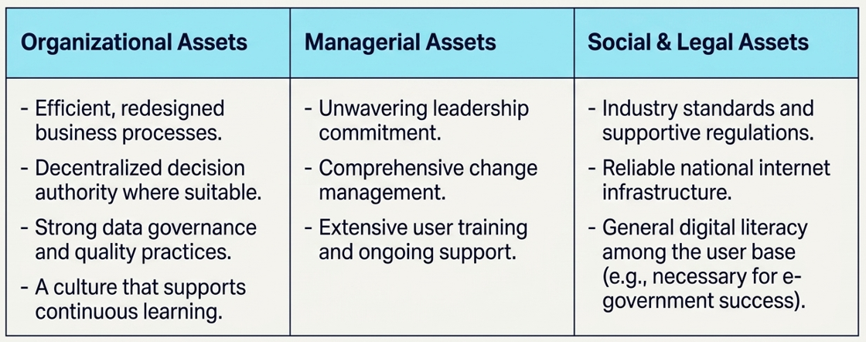
Complementary Assets
Organizations must intentionally develop three groups of complementary assets:
Notes:
1. Organizational Assets
Internal structure and work processes that support the system
The university must redesign admission, course registration, attendance, exam, result, and payment processes so they work smoothly online.
2. Managerial Assets
Support and guidance from management
Top management must strongly support the smart university project, manage change, and ensure teachers, students, and staff use the system properly.
3. Social & Legal Assets
External rules, infrastructure, and social readiness
The system needs education board/UGC rules, data privacy policy, reliable internet, and students/teachers who can use digital tools.

Slide 38
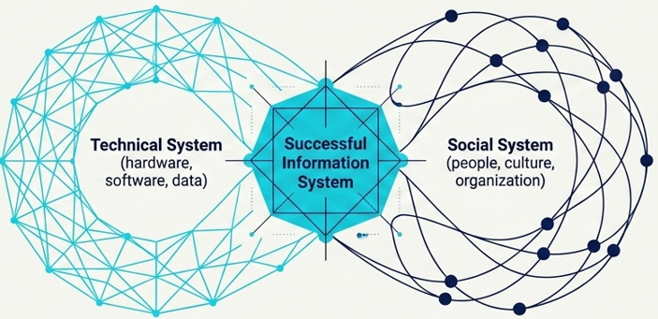
Study on Information Systems
The study of information systems and their development is a multi disciplinary subject.
It addresses the range of strategic, managerial and operational activities involved in the gathering, processing, storing, distributing and use of information, and its associated technologies, in society and organizations.
It examines more than just the technological system, or just the social system. It investigates the phenomena that emerge when the two interact.
Notes:
1. What it studies:
The study of Information Systems (IS) looks at how information is collected, stored, processed, shared, and used in organizations and society.
2. Multi-disciplinary:
It combines ideas from technology (like computers and software) and social sciences (like management, behavior, and communication).
3. Focus:
Not just about computers or technology.
Not just about people or social systems.
Focuses on what happens when technology and people work together.

Slide 39
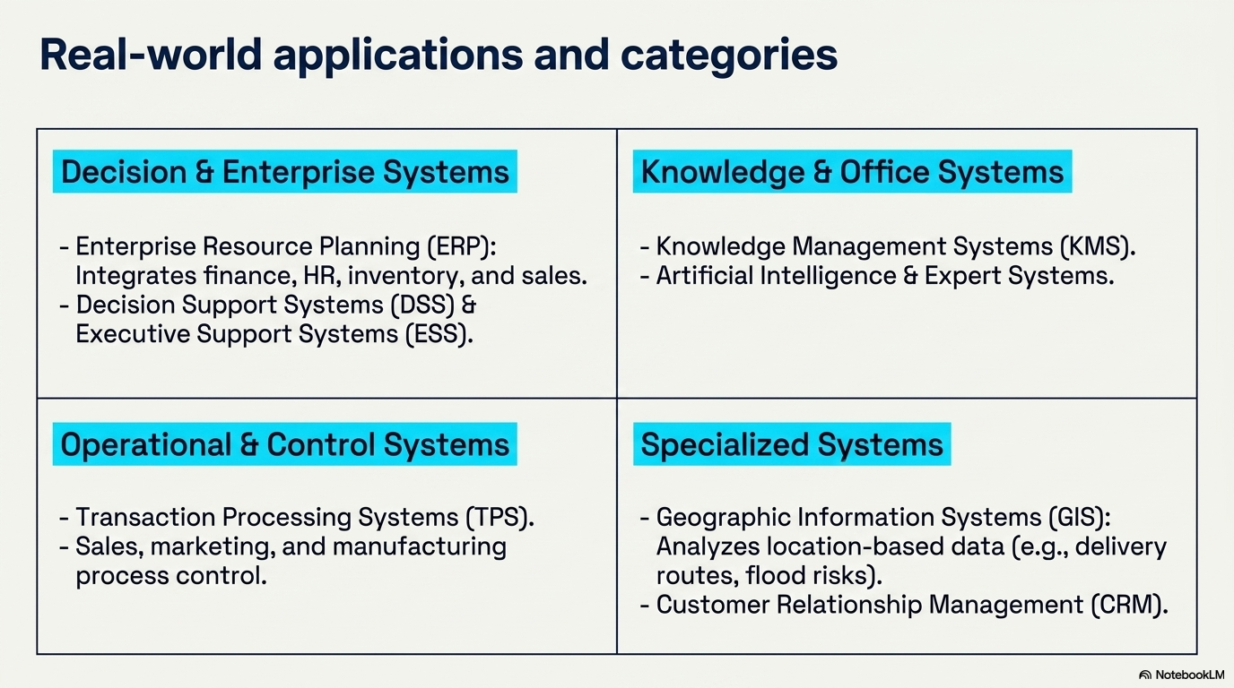

Slide 40
The END

